Slide 1
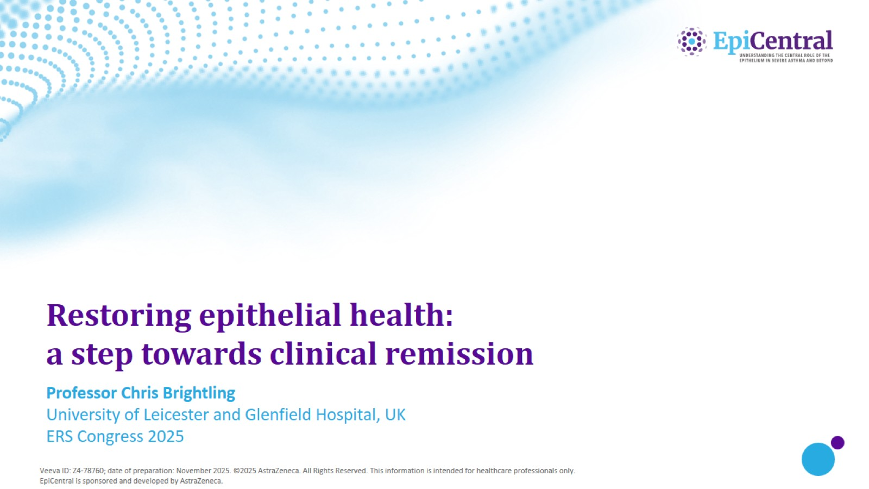
Restoring epithelial health: a step towards clinical remission

Slide 2
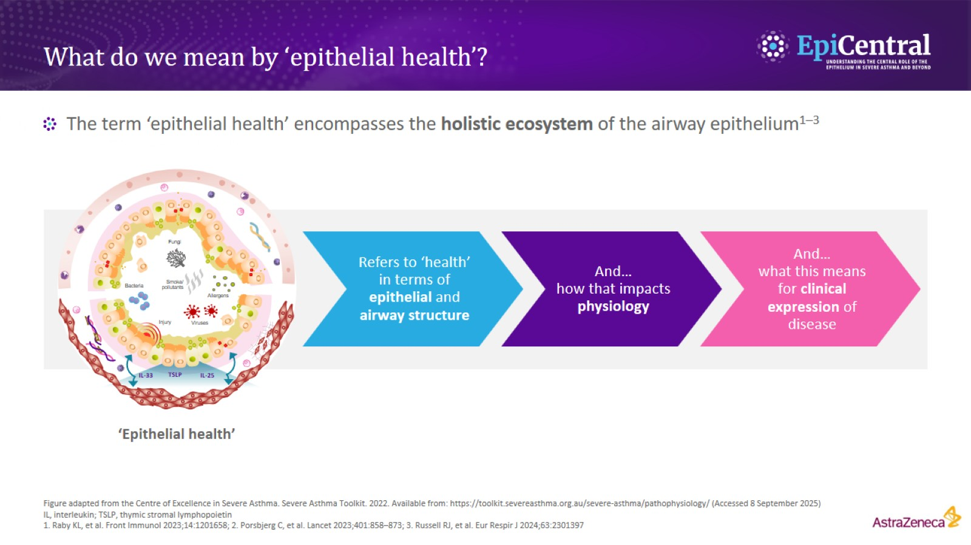
What do we mean by ‘epithelial health’?

Slide 3
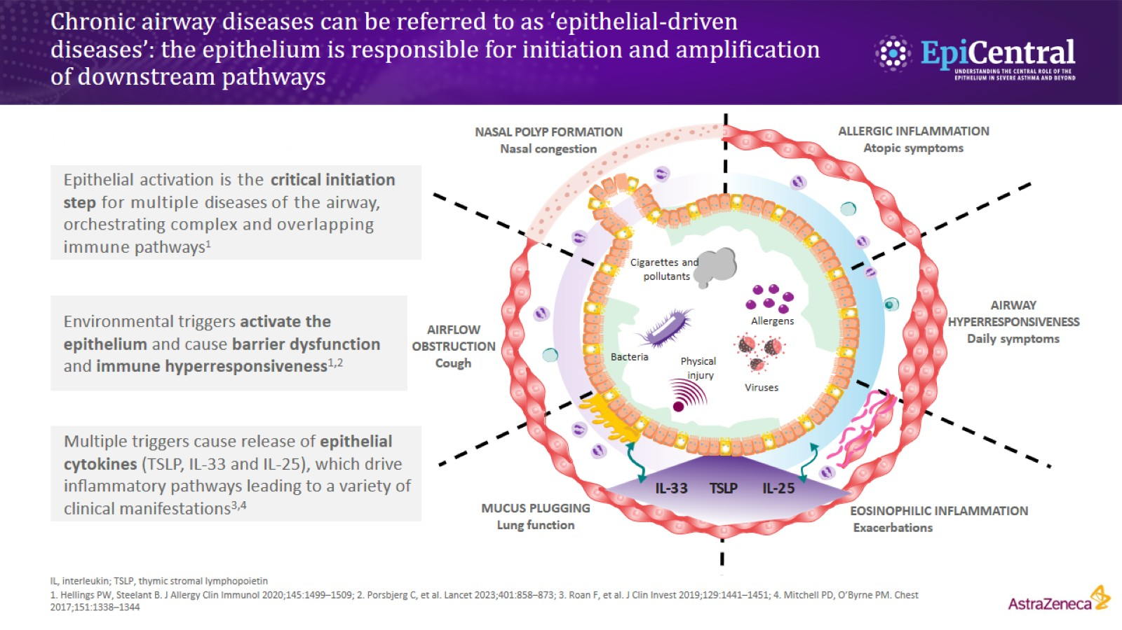
Chronic airway diseases can be referred to as ‘epithelial-driven diseases’: the epithelium is responsible for initiation and ampliﬁcation of downstream pathways

Slide 4
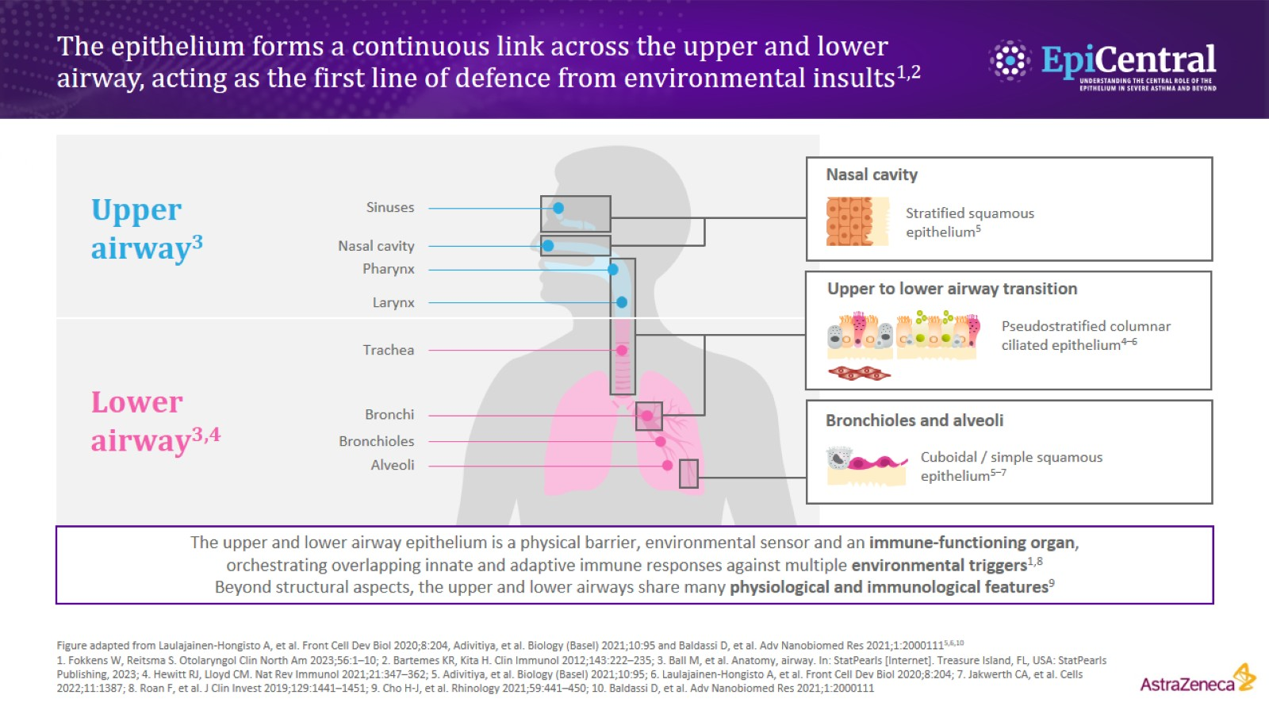
The epithelium forms a continuous link across the upper and lower airway, acting as the first line of defence from environmental insults^{1,2}

Slide 5
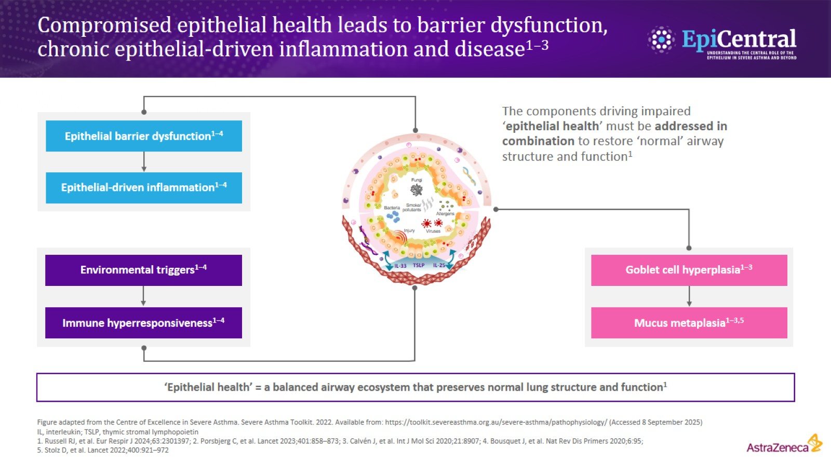
Compromised epithelial health leads to barrier dysfunction, chronic epithelial-driven inflammation and disease^{1–3}

Slide 6
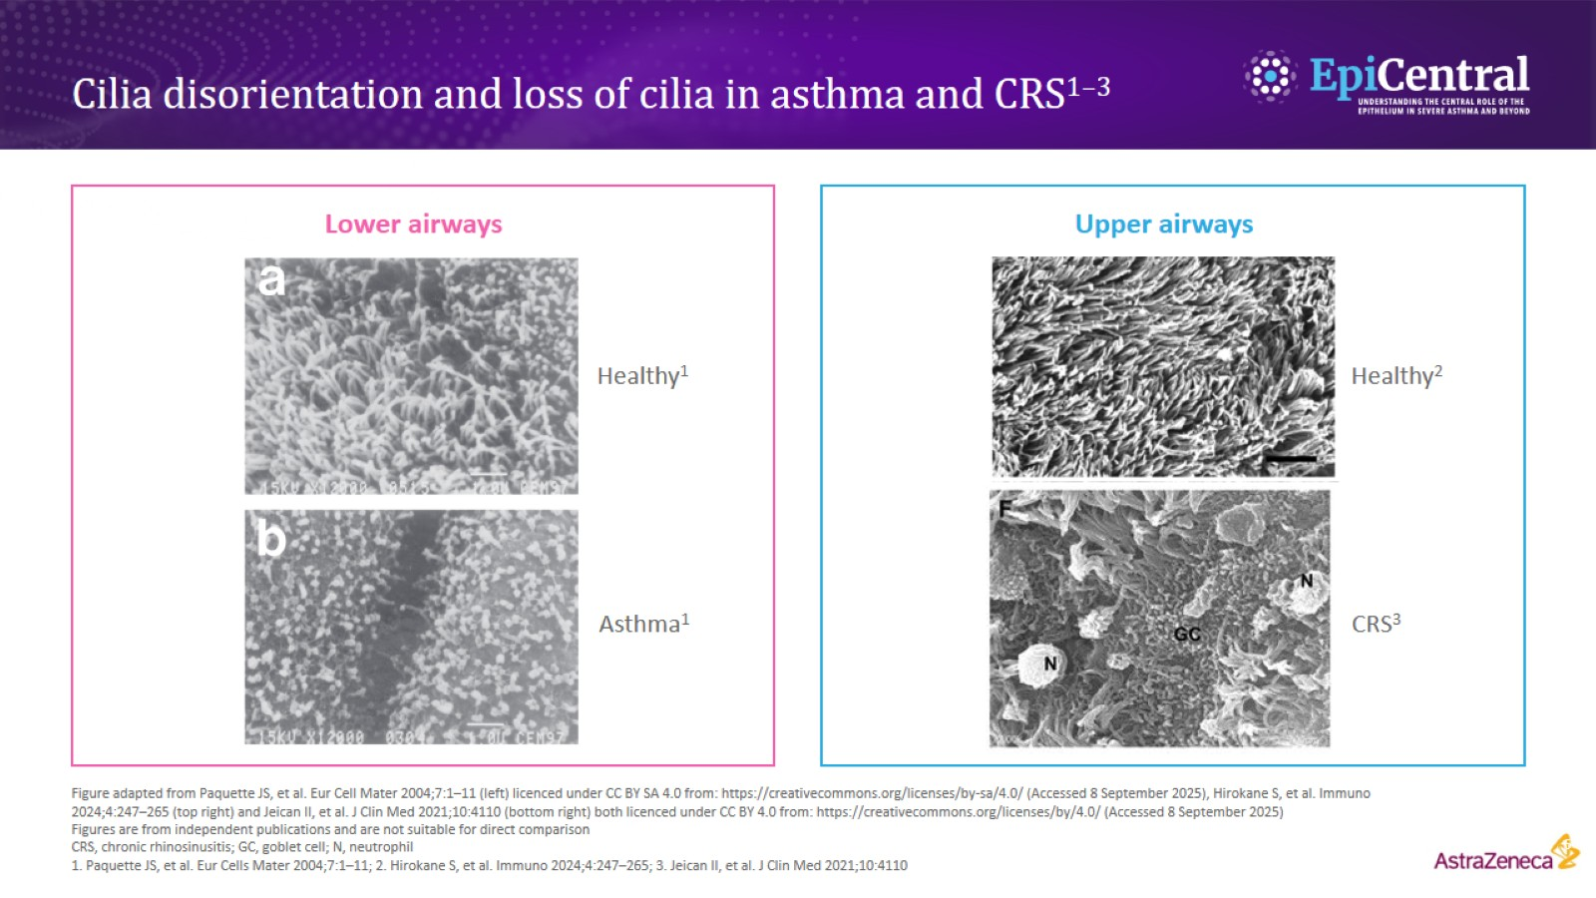
Cilia disorientation and loss of cilia in asthma and CRS^{1–3}

Slide 7
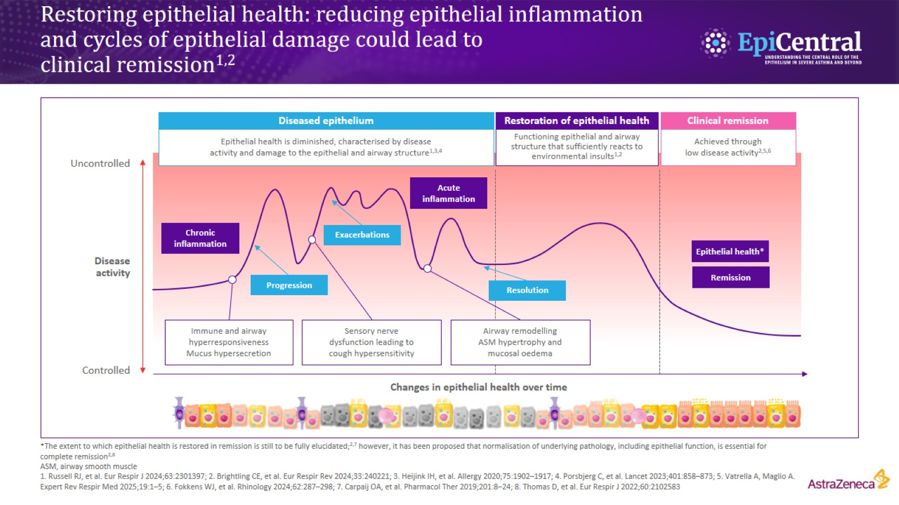
Restoring epithelial health: reducing epithelial inflammation and cycles of epithelial damage could lead to clinical remission^{1,2}

Slide 8
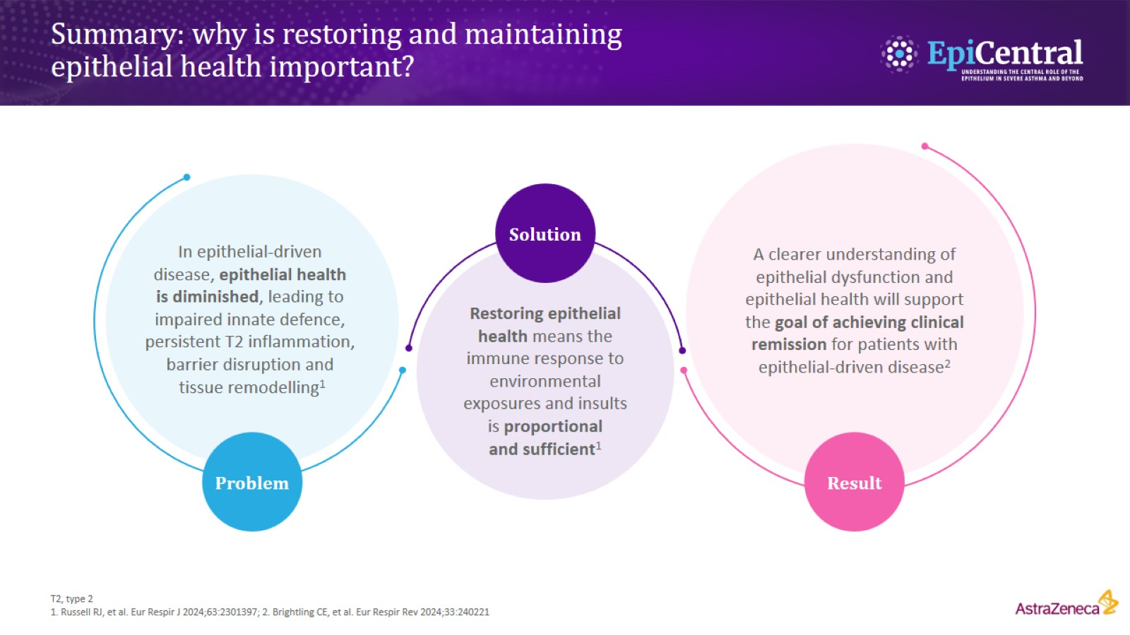
Summary: why is restoring and maintaining epithelial health important?

